Slide 1
Sales and Marketing Dashboard
Month, Day, Year

Slide 2
Top Takeaways

Slide 3
Top Takeaways in March
March was massively variable with significant value added to and taken from the pipeline. We had a great month in terms of wins and creating new deals while at the same time closing-lost $X.XM, nearly $X.XM more than any other month in FY20. Fortunately, these were largely early stage deals, so had a muted impact on the weighted pipeline. I expect we will see more deals closed-lost or delayed in the coming months, making bringing in new deals even more critical than usual.
Highest value of deals created by far in FY20 - $X.XM
$X.XM in the US
$X.XM in electrical engineering and $X.X in SCADA
Highest value of deals won by far in FY20 - $XM
$X.XM in Australia
Drop of $X.XM in total value in March
These were primarily early stage deals so the weighted value only decreased $X.XM
Caused by $X.XM in wins in APAC and $XM in lost deals in Europe
$X.XM reduction in WEMS, $X.XM in SCADA, $XXXK in HVDC
Offset by significant value created

Slide 4
Sales Metrics

Slide 5
Total Value of Open Opportunities
* Open Opportunity = Qualifying, Proposal, Negotiating, Won Not Booked

Slide 6
Total Value of Open Opportunities
* Open Opportunity = Qualifying, Proposal, Negotiating, Won Not Booked

Slide 7
Weighted Value of Open Opportunities

Slide 8
Weighted Value of Open Opportunities

Slide 9
Total Value of Opportunities Created by Month and Service Line
Jan – $X.XM
Feb – $X.XM
Mar - $X.XM

Slide 10
Total Value of Opportunities Created by Month and Region

Slide 11
Total Value of Closed Won by Month and Service Line
Jan – $X.XM
Feb – $X.XM
Mar - $X.XM
Figures based on Opportunity Close Date

Slide 12
Total Value of Closed Won by Month and Region
Figures based on Opportunity Close Date

Slide 13
Total Value of Closed Lost by Month and Service Line
Jan – $X.XM
Feb – $X.XM
Mar - $X.XM
Figures based on Opportunity Close Date

Slide 14
Total Value of Closed Lost by Month and Region
Figures based on Opportunity Close Date

Slide 15
Average Age of all Open Opportunities (days)
Oldest outstanding 1,604 days

Slide 16
Total Value of Committed Opportunities

Slide 17
Marketing Metrics

Slide 18
Marketing Metrics

Slide 19
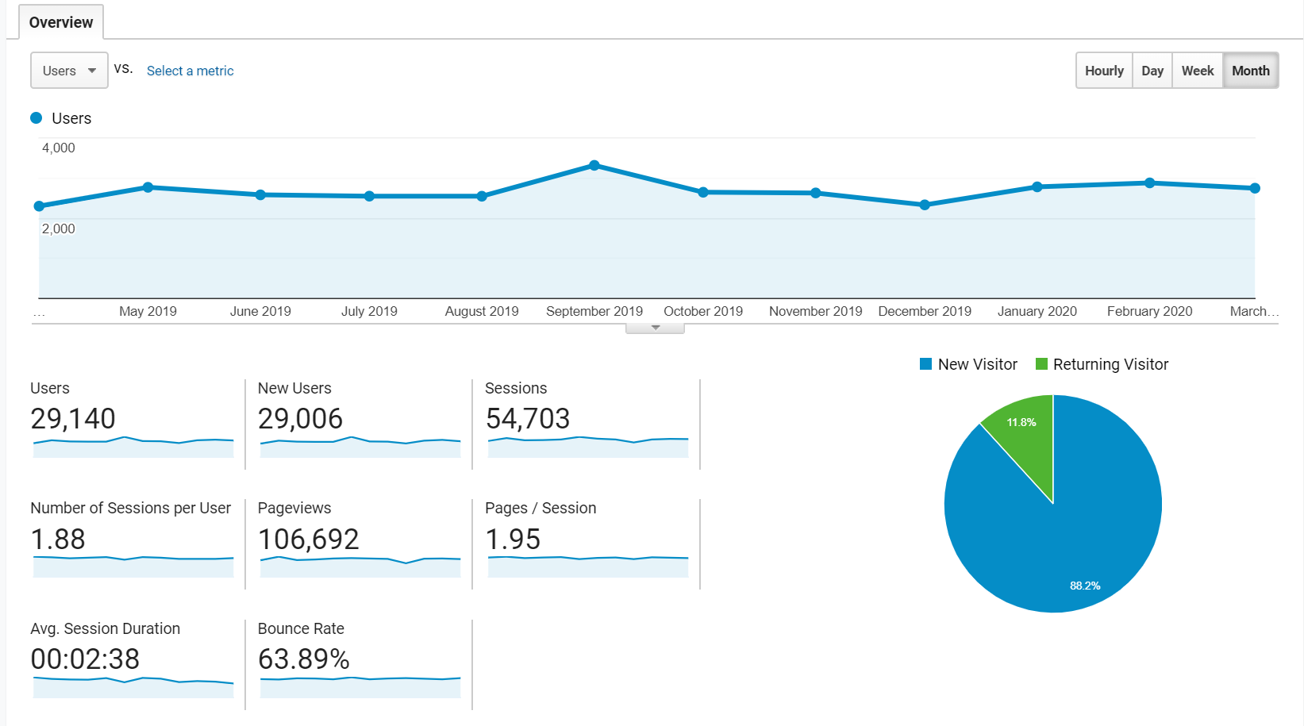
Website Traffic Trend – Calendar Year by Month
Notes:
Last 12 months by month. This one is April 1, 2019 – March 31, 2020.

Slide 20
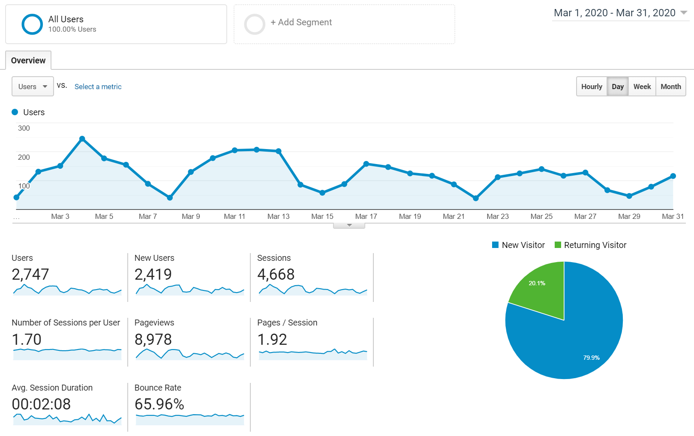
Website Traffic Trend – Last Month by Day
Dec – X,XXX
Jan – X,XXX
Feb – X,XXX
Mar – X,XXX

Slide 21
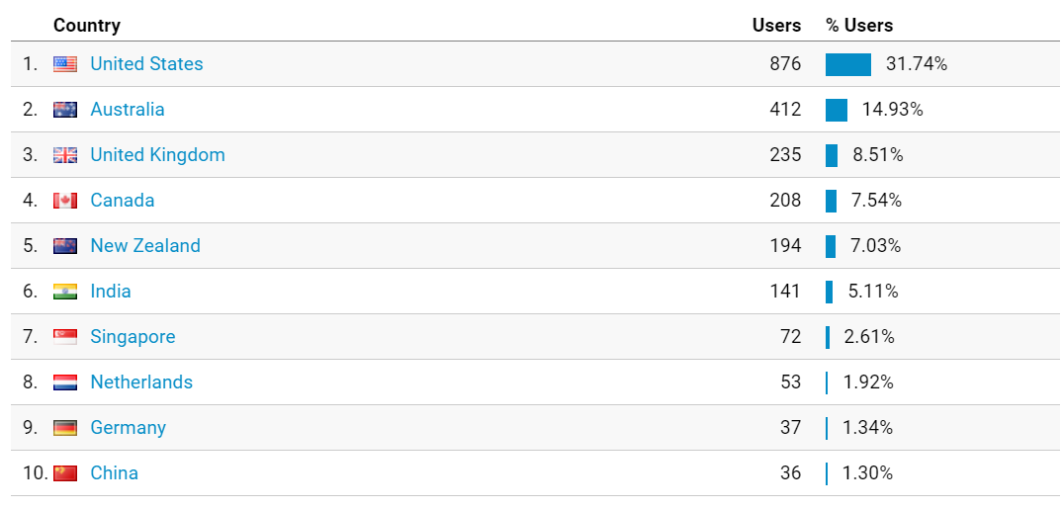
Website Audience Snapshot Last Month

Slide 22
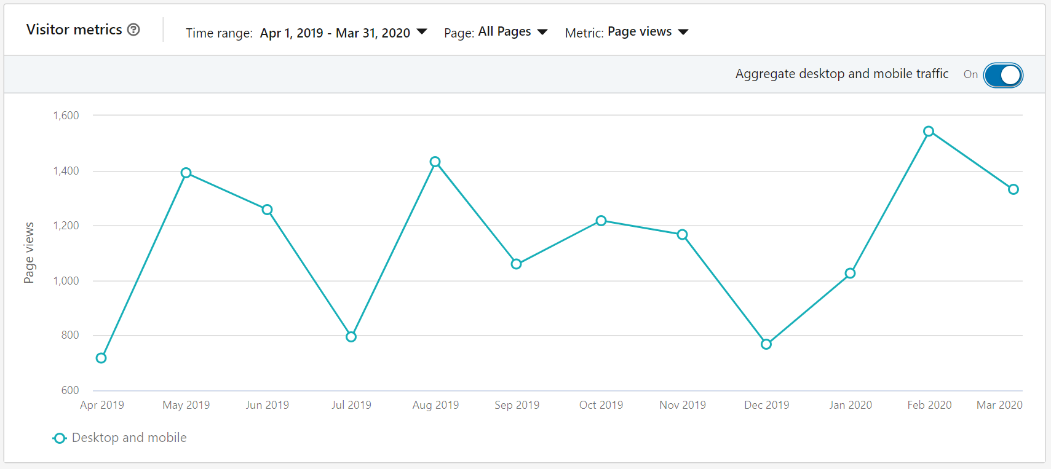
LinkedIn Traffic Trend – Calendar Year by Month

Slide 23
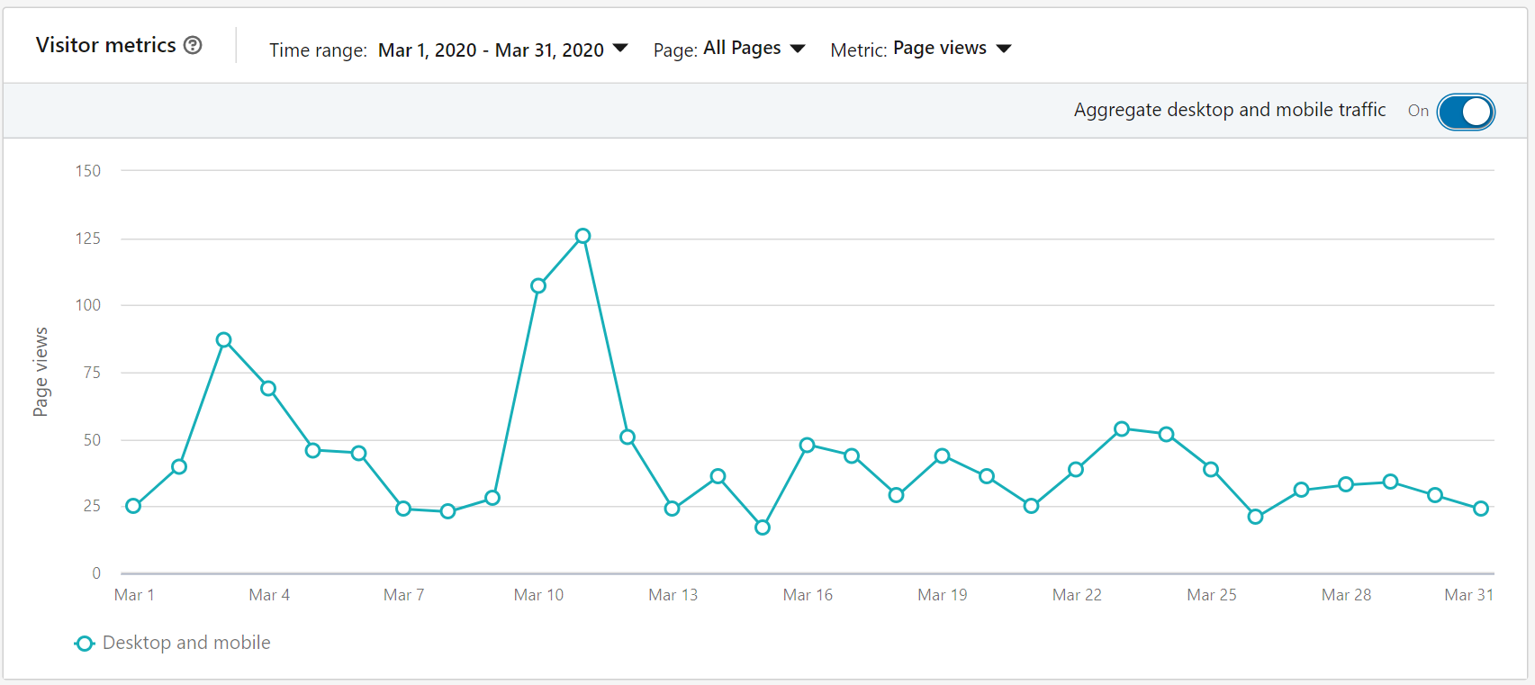
LinkedIn Traffic Trend – Last Month by Day
XXX seeking principal engineer
CEO to deliver DSPS keynote Hiring notice – Principal Engineer
XXX News – photo of Ramboll team
1
3
2
Notes:
No post, webpost, or external email aligned with Feb 24 spike.

Slide 24
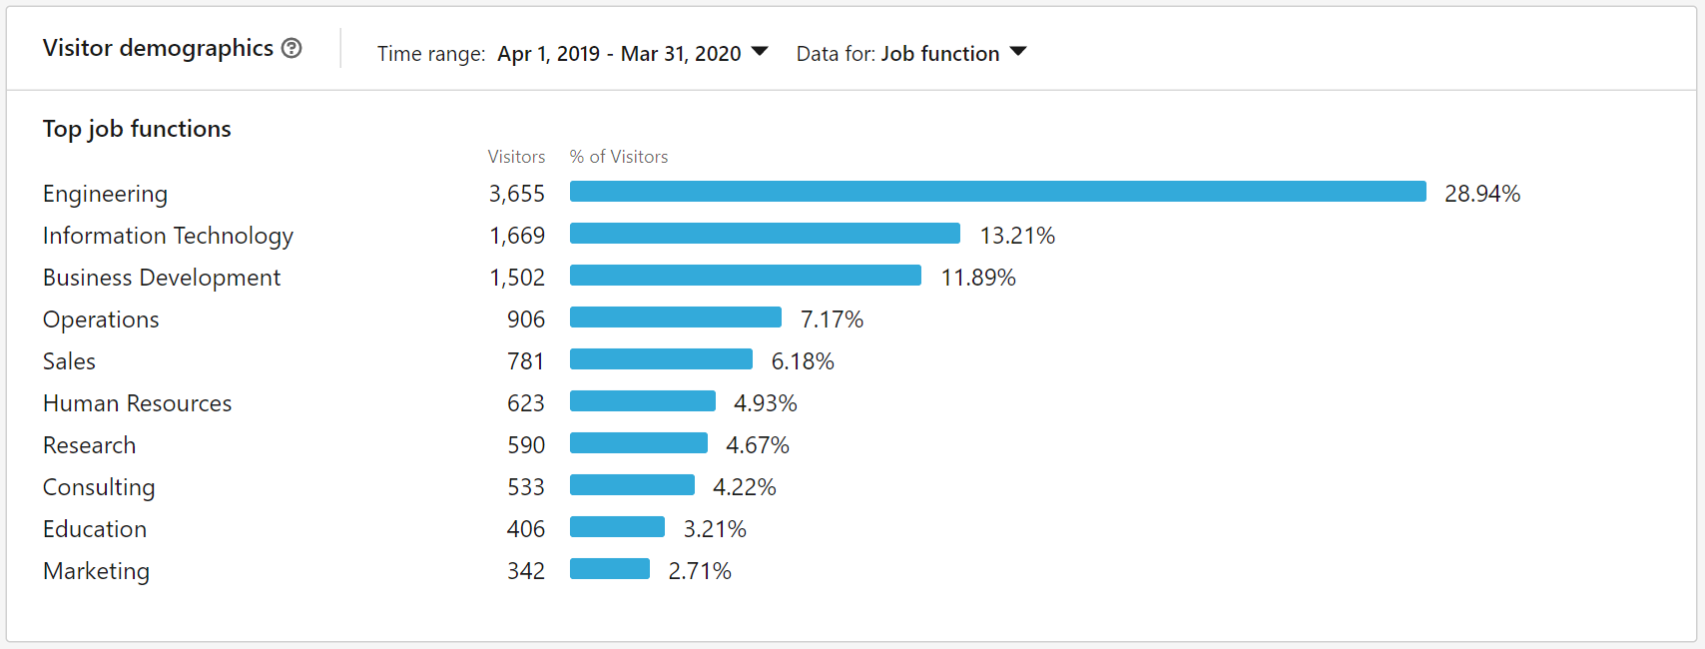
LinkedIn Demographics Calendar Year to Date

Slide 25
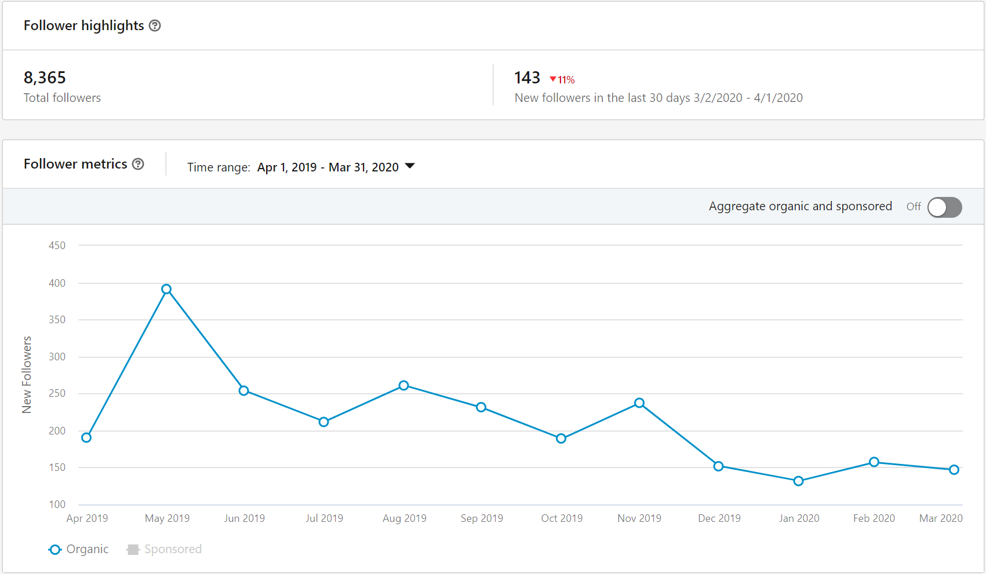
LinkedIn Followers – Total &Last Year by Month
Our goal is XXk followers

Slide 26
Thank you!
Contact name Phone email

