Slide 1
How to use this presentation
Pick a cover slide appropriate to your region. You may replace the image with one of your own. Directions are in the Notes section of the slide.
Choose one of the 3 Service Line Animation options (YouTube video, printer-friendly white background or photo background) and delete the other two.
Pick the most relevant client logos according to your region and audience to customize the Our clients slide. Roughly 12 logos is a good number.
Include up to 3 relevant projects, following the WHO/WHAT/HOW/WHY structure from the examples included.
Feel free to customize slides and delete unnecessary ones.
When finished, update the table of contents, if necessary.
If you have any problems or need graphics support, contact LISA or GAYLE.
“This template is a tool to help you build your presentation:
not a strict process to follow!”

Slide 2
We help you power a more sustainable world.
[Enter client name] | MONTH YY | Presented by [Your name]
Notes:
Global (and US) cover. To replace cover image:
Click View/Master/Slide Master
Go to the Cover Slide for your region
Right click on this picture, then click Change picture
Make sure your new image size follows a 16.9 ration for this template (Ex: 1920x1080)

Slide 3
We help you power a more sustainable world.
[Enter client name] | MONTH YY | Presented by [Your name]
Notes:
APAC cover

Slide 4
We help you power a more sustainable world.
[Enter client name] | MONTH YY | Presented by [Your name]
Notes:
UK/Europe cover

Slide 5
We help you power a more sustainable world.
[Enter client name] | MONTH YY | Presented by [Your name]
Notes:
NA/Canada cover

Slide 6
Table of contents
Our vision / Our mission
Our values
Our story
Our locations
Our services
Our clients
Our leadership team
Our projects

Slide 7

Our vision
Our mission
We want to be regarded globally as electricity
experts, working with the energy industry to
sustainably deliver power and improve the
quality of human lives.
“We deliver expertise and solutions to utilities and energy companies around the world, empowering them to innovate and thrive in a rapidly changing industry.”

Slide 8






Our values
Share
a common goal
Foster
bright ideas
Collaborate
globally
Invest
in the future
Celebrate
success

Slide 9
The [Company] story
1995
2007
2017
[Company] is founded.
[Company] North America is founded.
[CEO] becomes the new CEO
1999
2015
[Company] Australia is formed.
[Company] Europe is formed.

Slide 10




[Company] at a glance
197
200⁺
25
25⁺
CLIENTS
YEARS IN
BUSINESS
COUNTRIES
SERVED
SUBJECT
MATTER
EXPERTS

Slide 11
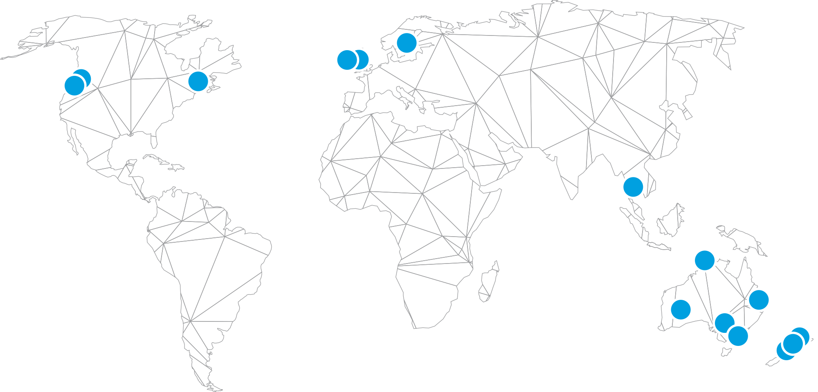
15 locations for a worldwide presence

Slide 12

6 service lines. 1 group.
Notes:
Embedded YouTube video – must be in slideshow mode to play.

Slide 13






6 service lines. 1 group.
LOGO
Notes:
White background animation. (13-20) These animate by your click, so you can speak to each one and move through at your own pace.

Slide 14
6 service lines. 1 group.
We help our clients improve grid operations by advancing and supporting the use of network monitoring and control technologies.
LOGO

Slide 15
6 service lines. 1 group.
We help our clients develop and support their energy market systems with our broad, vendor-neutral technical engineering and software development expertise.
LOGO

Slide 16
6 service lines. 1 group.
We help our clients design, deploy and maintain their HVDC projects with our deep technical expertise in all aspects of HVDC and its interfaces.
LOGO

Slide 17
6 service lines. 1 group.
We help our clients design, operate, and optimize the effectiveness and efficiency of their DER with our end-to-end capabilities and global DER project experience.
LOGO

Slide 18
6 service lines. 1 group.
We help our clients innovate and succeed with access to our global thought leaders and full spectrum of experience in developing, implementing and operating electricity and energy assets.
LOGO

Slide 19
6 service lines. 1 group.
We help our clients plan with confidence with our extensive experience in the modeling, analysis and planning of transmission and distribution networks.
LOGO

Slide 20
6 service lines. 1 group.
LOGO

Slide 21
LOGO
Notes:
Dark background animation. (21-28) These animate by your click, so you can speak to each one and move through at your own pace.

Slide 22

We help our clients improve grid operations by advancing and supporting the use of network monitoring and control technologies.

Slide 23

We help our clients develop and support their energy market systems with our broad, vendor-neutral technical engineering and software development expertise.

Slide 24

We help our clients design, deploy and maintain their HVDC projects with our deep technical expertise in all aspects of HVDC and its interfaces.

Slide 25
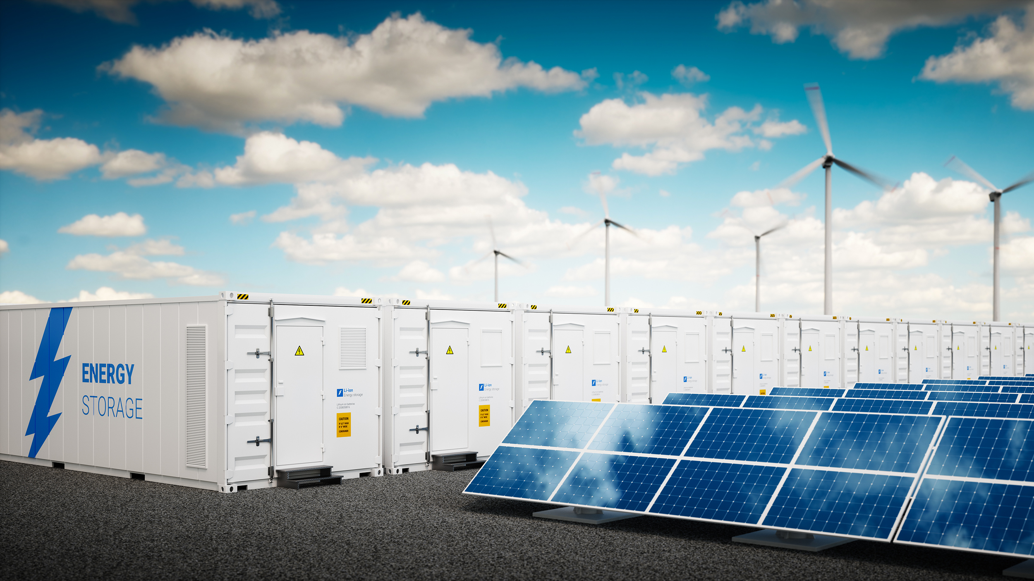
We help our clients design, operate, and optimize the effectiveness and efficiency of their DER with our end-to-end capabilities and global DER project experience.

Slide 26

We help our clients innovate and succeed with access to our global thought leaders and full spectrum of experience in developing, implementing and operating electricity and energy assets.

Slide 27

We help our clients plan with confidence with our extensive experience in the modeling, analysis and planning of transmission and distribution networks.

Slide 28
LOGO

Slide 29












Our clients

Slide 30
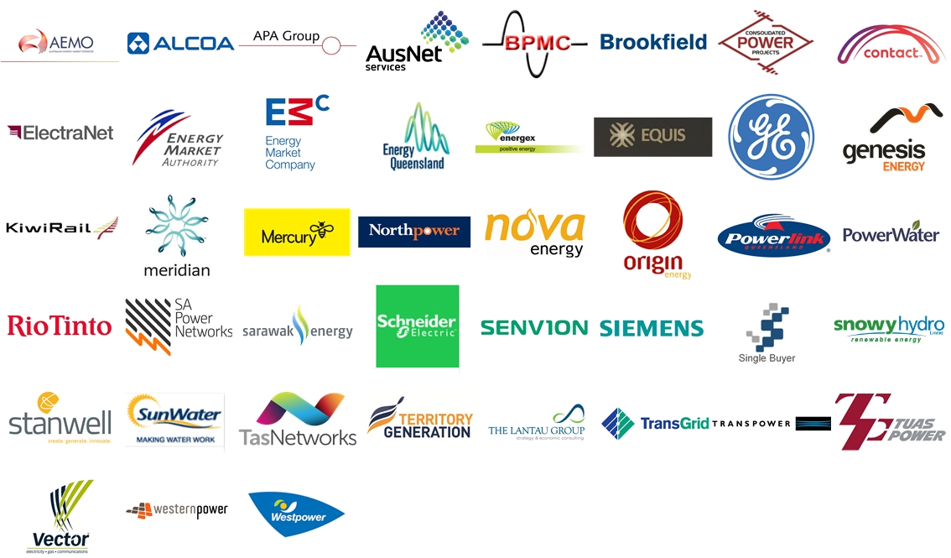
Asia Pacific clients

Slide 31

North American clients

Slide 32


European clients

Slide 33
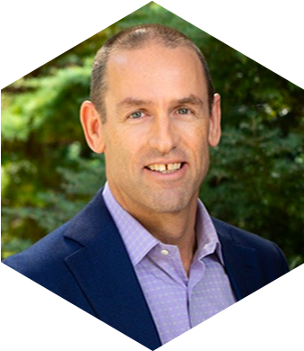
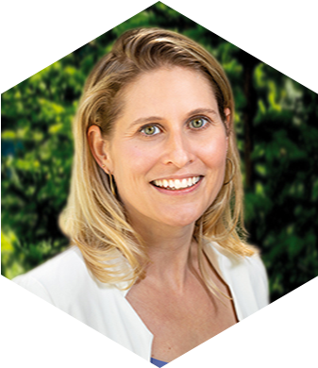
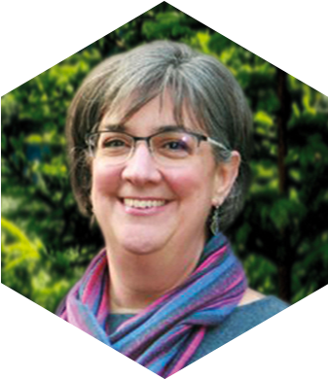
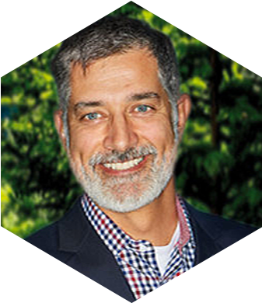
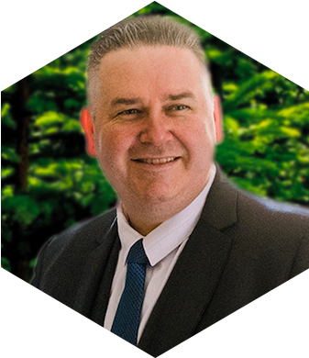
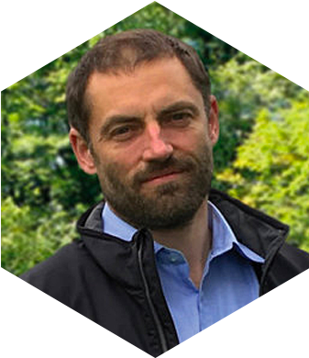
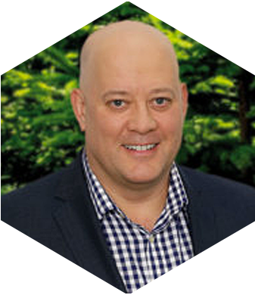
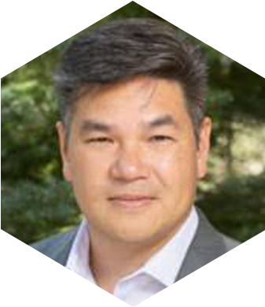
Our leadership team
Alex Boyd
President & CEO
Sandi Li Santi
Senior Manager,
Business & Strategy
Ann Bhat
Director of HR
Tim Ritchie
Chief Revenue Officer
Glenn Pallensen
Director of Operations
Tim Miles
MD Europe
Roger Riley
MD Asia Pacific
Kevin Cheung
MD North America

Slide 34
Our Projects
Notes:
Optional section cover

Slide 35
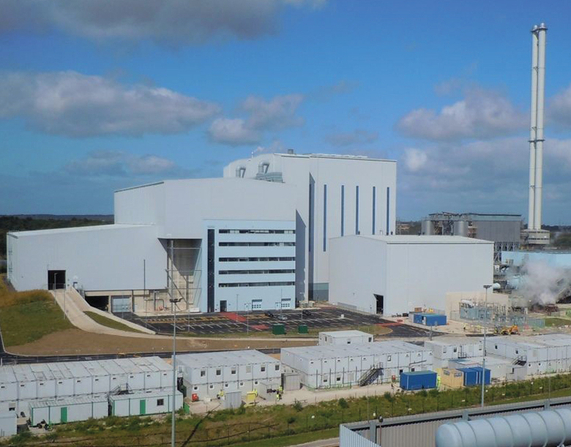
Waste-to-energy grid connection for WTI
WHO
  WTI (Wheelabrator Technologies) plan, build and operate waste-to-energy facilities in the UK and US.
WHAT
  WTI required technical support in discussions with their local DNO about a flexible grid connection for a new plant in development in Wales.
HOW
  [Company] provided electric system connection, technical and regulatory support through all phases of the project to ensure successful grid synchronization.
WHY
  In order for WTI to do business as a renewable energy producer under Great Britain’s scheme, they needed to confirm a portion of the electricity comes from renewable sources. [Company] provided the necessary technical support to register the generator with the Regulator as a renewable energy producer and gave ongoing guidance to maintain the renewable status of the facility.

Slide 36


Due diligence studies and advisory for solar farm
WHO
  Electranet is the Transmission Network Service Provider for South Australia.
WHAT
  Electranet requires all new generators to submit a connection application proving they can meet the Generator Performance Standards and are within all the regulatory guidelines.
HOW
  [Company] performed due diligence studies to verify that the proposed 280 MW Cultana Solar Farm would meet the Generator Performance Standards before connection to the South Australian transmission network and the National Electricity Market.
WHY
  In order to provide safe, efficient, reliable and regulatory-compliant electricity transmission service, Electranet must ensure the accuracy and conformity of new generation to the proposed Generator Performance Standards and meets all the National Electricity Requirements.

Slide 37

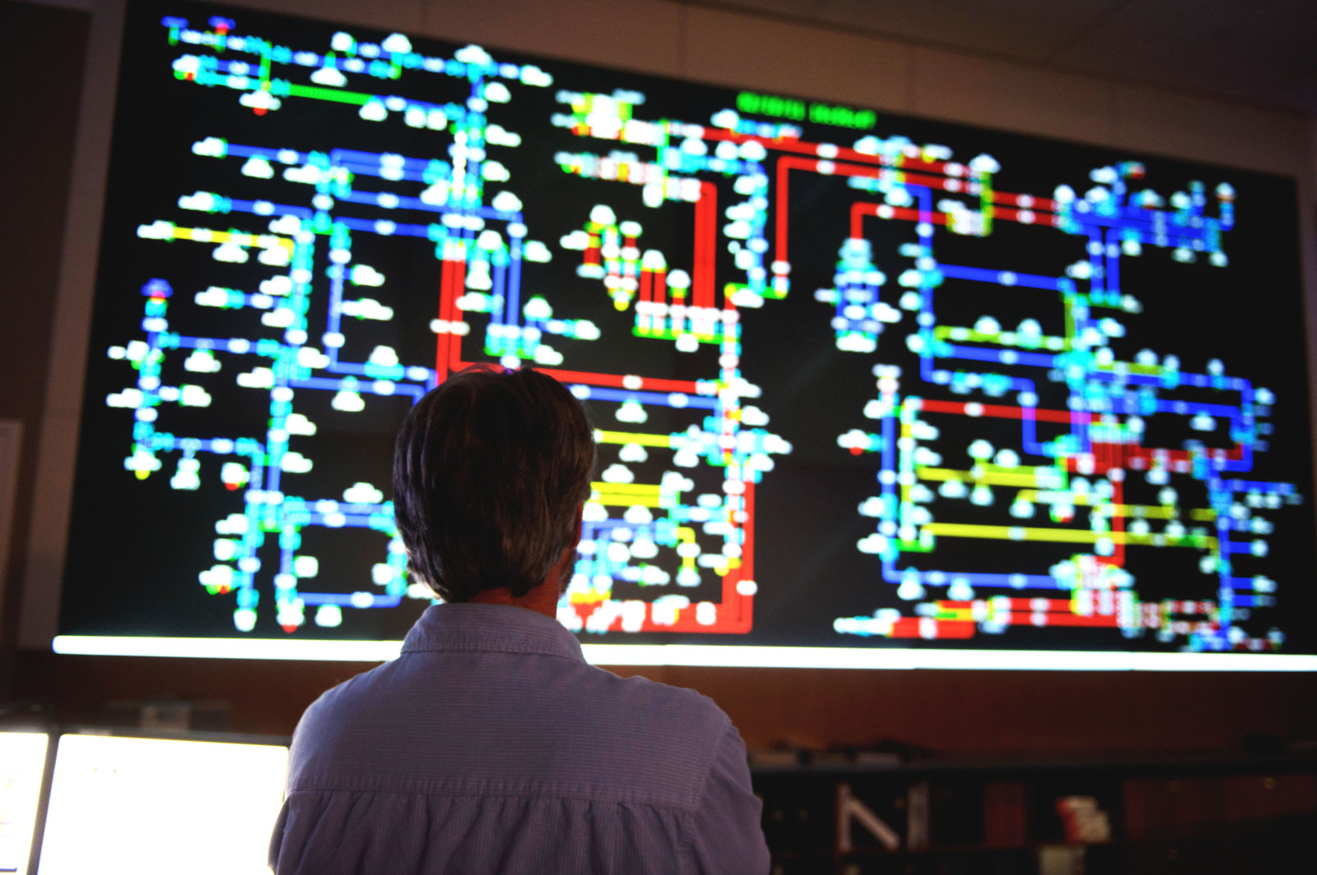
Energy Management System roadmap
WHO
  ATCO Electric delivers electricity to 227,000 customers in Alberta, Canada.
WHAT
  ATCO wanted a five-year strategy roadmap for the EMS to provide the framework they needed for planning and justification for growth and enhancement to their existing EMS over that period.
HOW
  [Company]’s EMS subject matter expertise and vendor-neutral position within the industry enabled a knowledgeable and unbiased assessment of the current system as well as ATCO needs. The project approach was to assess the state of the system both internal to ATCO and externally, relative to regional peers, regarding the state of the art within the EMS vendor marketplace.
WHY
  To “create a vision for operational excellence and a clear path on how to get there.”
“The EMS roadmap helped ATCO to better understand current and upcoming technologies in the utility industry, identify areas of operational technology weaknesses and develop a clear path for future improvement. It creates a vision for operational excellence and a clear path on how to get there.”
- Hieu Tran, Supervising Engineer, System Operations
ATCO Electric

Slide 38
Build your own project summary – no quote
WHO
  One sentence about the client (what type of company, what country, how many customers, etc.)
WHAT
  One-two sentences about the challenge the client was trying to solve.
HOW
  One-two sentences about what we delivered.
WHY
  One-two sentences about the value our solution brought. It may be from a technical/business/regulatory standpoint.

Slide 39
Build your own project summary – with quote
WHO
  One sentence about the client (what type of company, what country, how many customers, etc.)
WHAT
  One-two sentences about the challenge the client was trying to solve.
HOW
  One-two sentences about what we delivered.
WHY
  One-two sentences about the value our solution brought. It may be from a technical/business/regulatory standpoint.
“Type your client quote in this box.”
- Client Name, Title and Company

Slide 40
LOGO
Notes:
To edit this slide, go to: View/Slide Master

