Slide 1
Buddy Ohm Sales Training
Tim Ritchie
VP of Sales

Slide 2
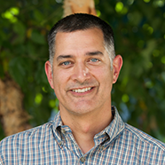

Hello,
Tim Ritchie
VP of Sales & Account Management
David McLauchlan
CEO
Tim joined Buddy in February, 2016. He spent the last 15 years leading sales teams for young technology companies that sell into enterprise accounts. He has a passion for reducing environmental impact and technology, making Buddy Platform a great fit.
Dave founded Buddy Platform in 2011as a Mobile Backend as a Service following a successful career at Microsoft. He has a passion for technology and a fundamental belief in the power of big data solutions to provide insight in ways not previously possible.

Slide 3
Agenda
Who Cares?
Solution Overview
Finding Prospects and Positioning
Closing Deals and Maximizing Value
Buddy Ohm Introductory Presentation
Results to Date
Sales Resources
Interpreting Dashboards
Product Roadmap

Slide 4

40% of the world’s energy usage is within buildings
40% of the world’s carbon footprint is from buildings
20% of the world’s available drinking water is consumed in buildings.
We believe building utility consumption is less efficient than it should be and we decided to address that.

Slide 5

We thought: what if we created a “FitBit” for buildings?
…a device that would capture the resource consumption metrics for buildings?
Like a FitBit, it would provide real-time actionable feedback
… and could be sold into any market.

Slide 6
Products exist that do this… but they’re terrible
(some combination of: expensive, hard to use, no access to data, only monitor electricity, ugly).

Slide 7
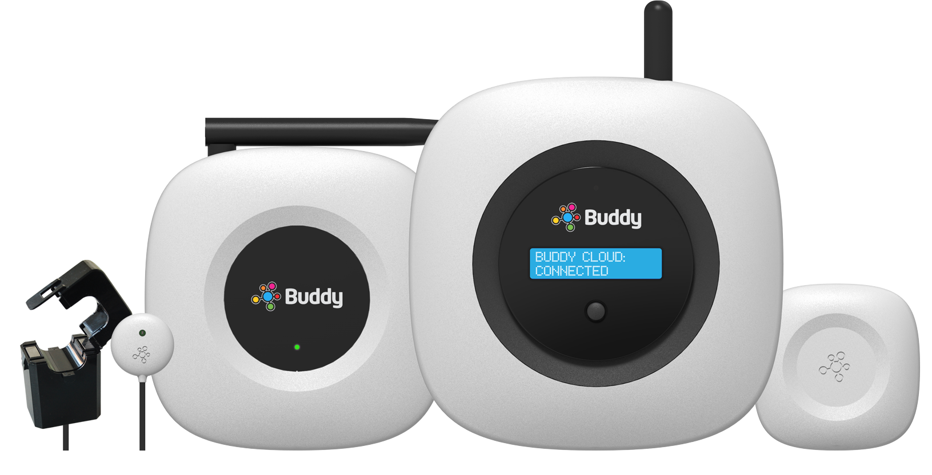
Introducing Buddy Ohm
Buddy Ohm enables facilities managers and building operators to identify and correct resource waste in their building.

Slide 8

Solution Overview
Pumps
Fans
Consumption
By Floor
Cooling
Lighting
Buddy Ohm provides facility managers granular insight into utility consumption enabling them to reduce utility waste and save money
Combination of hardware, communication and cloud-based software
Provides near real time insight into utility consumption
Guest comfort
Food prep compliance

Slide 9
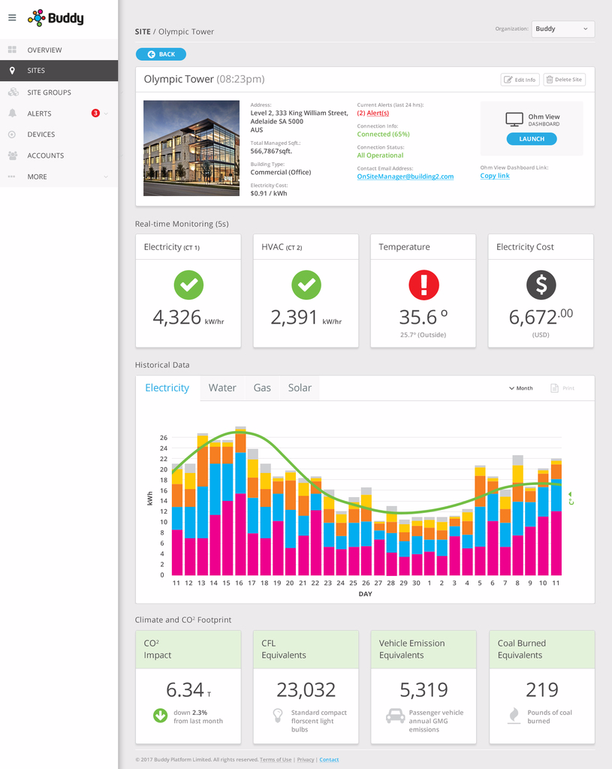
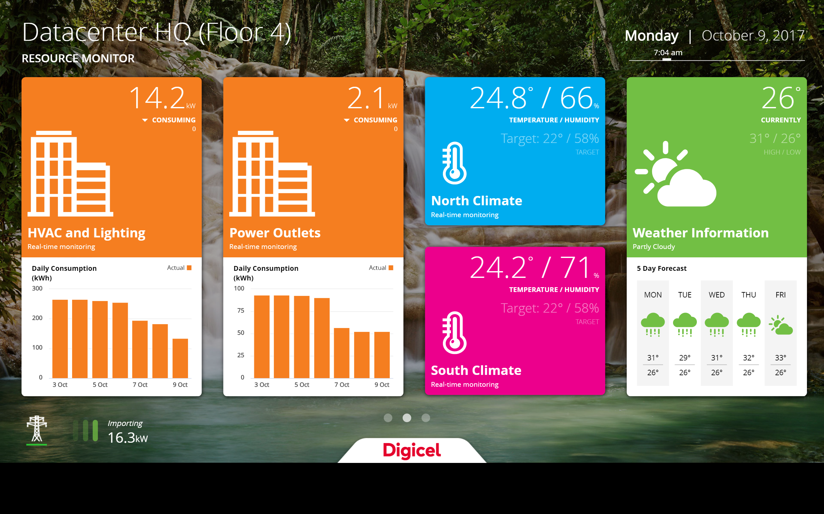
Views into the Data
Operations Dashboard
Occupant Dashboard

Slide 10
Value Proposition
Most clients save 6-17% net of Buddy Ohm cost
“Fitbit for buildings”
Unprecedented understanding of utility consumption
Brand promise
  Easiest to install
  Intuitive to use
  Inexpensive

Slide 11

Prospect Profile
Commercial buildings
Spending >$25,000 per month on utilities
Older buildings
Buildings without energy submetering
Prospects with critical equipment requiring constant power
Hospitality, Schools, Medical facilities, Office complexes

Slide 12
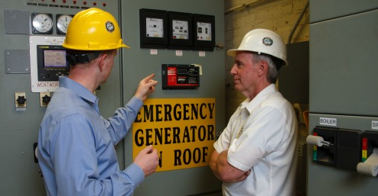
Target Titles
Environmental Focus
  Director of Sustainability
Facilities Focus
  VP or Director of Facilities
  Facility Manager
Cost Focus
  Cost Controller
  CFO
  President
  Dir. Of Strategic Sourcing

Slide 13

Why Prospects Buy
Save money (always #1 or #2)
Baseline known energy sinks
Surface unknown submeter resource consumption
Identify highest impact conservation projects
Identify delta between pre & post retrofits
Reduce carbon footprint

Slide 14
Solution Economics
$4,167/mo | Utility spend
$250/mo | Buddy Ohm charge
-$250/mo | 6% utility reduction
Solution breakeven
No capital expenditure
Three monitoring points at one site (building) $250 per month
Each additional monitoring point $25 per month per site (building)
Most clients save between 6-17% in utility spend
Solution typically breaks even with $4,200 monthly utility spend
Greater monthly spend likely results in more savings
Greater percentage reduction results in more savings

Slide 15

Exercise #1
Tell your story
  Paragraph background
  Profile picture
  Same for big Boss
5 minutes

Slide 16

Exercise #2
Turn to your neighbor and explain in two sentences
or less what Ohm by Digicel does
  Simpler is better
  Ask them to repeat your explanation back
  in their own words
  Did they understand?
10 minutes

Slide 17





Primer

Slide 18

Buddy Ohm
Buddy Ohm enables facilities managers and building operators to identify and correct resource waste in their building.

Slide 19

Environmental Sustainability
The fastest and most certain way to improve an existing situation is to establish a baseline, measure endpoints that contribute to the baseline, and identify opportunities for optimization.
Buddy Platform’s measurement and verification solution is the most cost-effective and simple way to reduce the total cost of building ownership while achieving environmental sustainability.

Slide 20
Effective resource measurement contributes to the bottom line
Real time insights into building performance contribute to overall cost reduction. They provide third party validation of utility expenditures; offer key metrics when results can be affected; demonstrate conformance with established expense goals; and provide a single view across multiple building systems and across multiple buildings within a portfolio.

Slide 21

Internet of Things (IoT)
Understanding our surroundings begins with effective measurement.
Buddy uses “Internet of Things” technologies to help building operators measure systems more affordably and more accurately than ever before.

Slide 22

Valuable Insights
The magic of the IoT is consuming vast amounts of data and transforming it into actionable information.
We believe that the mechanisms to achieve this have historically been out of reach for most organizations.
Buddy has changed that.

Slide 23

Meet Buddy
Established in 2011
Roots in mobile backend services and big data management
Corporate offices in Seattle and Adelaide, Australia
First publicly traded Internet of Things (“IoT”) company listed on Australian Securities Exchange (ASX:BUD).

Slide 24
Infrastructure Measurement & Verification
Since 2011, Buddy has been building an incredibly capable, stable, scalable, and secure IoT platform. We focus those capabilities in two broad categories – building measurement and verification and Smart Cities.
Building Resources
Providing intuitive tools and services to understand building utility consumption and opportunities for optimization.
City Infrastructure
Measurement and verification of connected City infrastructure, such as parking, irrigation, etc…
Municipal & Outdoor Lighting
Retrofitting existing street lighting infrastructure to add capabilities, including temperature & humidity sensing; lighting controls; rainwater measurement; air quality measurement; gunshot detection; sensing for chemical agents; status monitoring; and lighting control.

Slide 25

Capabilities

Slide 26






Measurement Capability
Buddy has democratized building measurement and verification by leveraging IoT hardware and technologies. We consume sensor data in real time, process it, and return information through intuitive visualizations within nanoseconds.
Grid Energy
Solar Energy
Gas
Climate
Water

Slide 27
Buddy Hardware
Buddy Platform’s resource monitoring and verification hardware changes the game. It is affordable, beautiful, non-invasive, accurate and simple to install.
CT Clip
Ohm Pulse
Ohm Link
Buddy Ohm
Ohm Sense

Slide 28
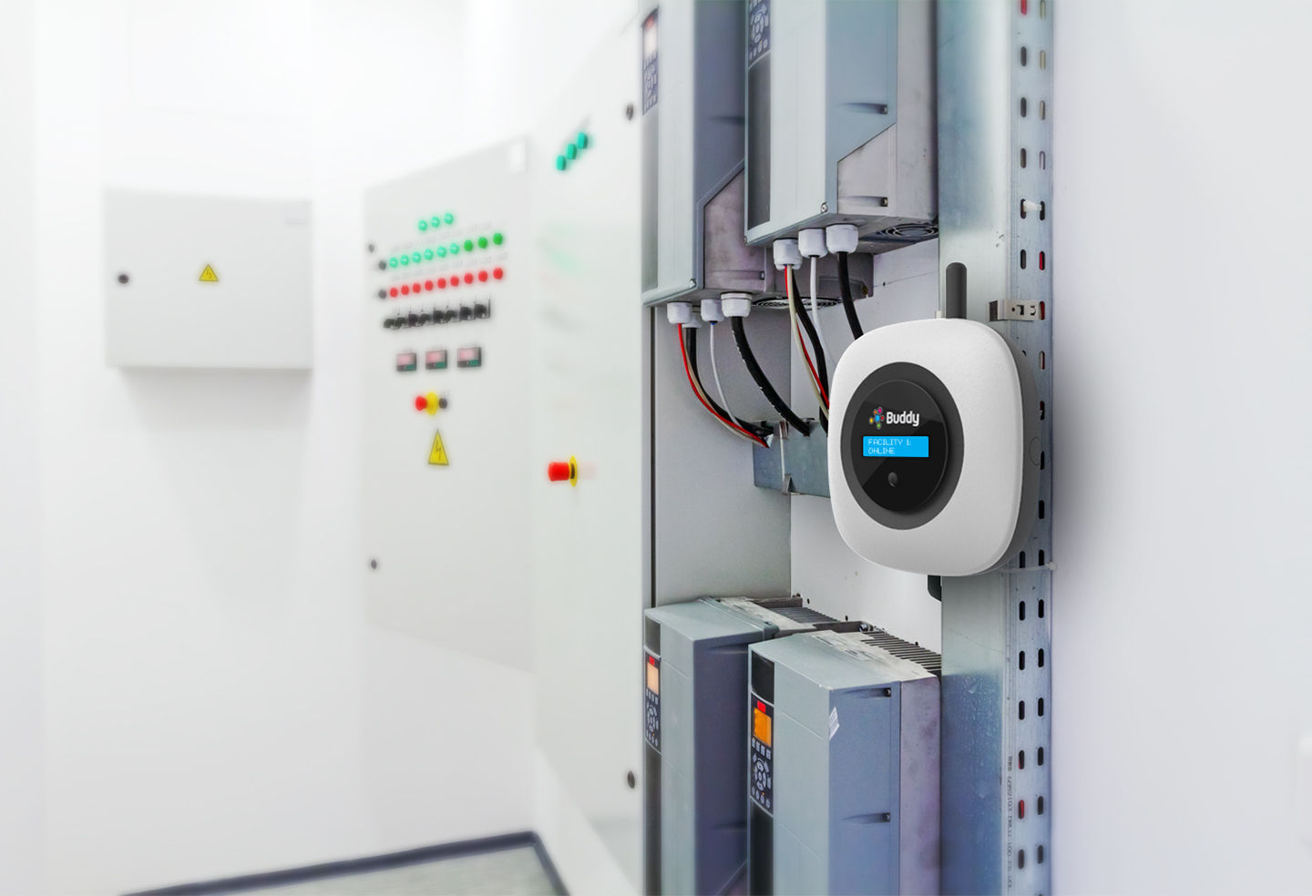
Simple Installation, Real-Time Insight
Sensing energy consumption and generation is easy with simple clips on monitored circuits. No need to bring the power down to begin gathering data.
BuddyOhm sensors communicate with the base unit via wired 4.5mm connections or RF for remote sensors. And, the base unit communicates to the Buddy Platform via WiFi or included cellular connection.
The base unit easily mounts via traditional mounting clips or simply magnetizes to a metal surface.

Slide 29
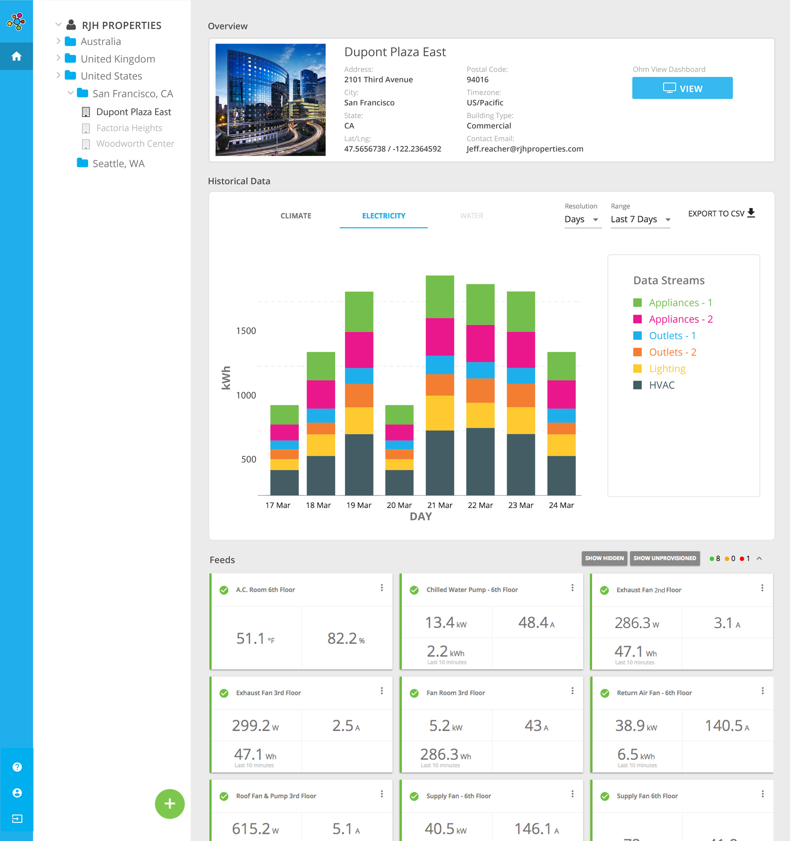
Operations Dashboard
Intuitive real-time and trended dashboards turn sensor data into insights.
Role-based dashboards for building tenants and/or building managers.
Custom built dashboards for more advanced data analytics
Real-time streaming or batch transfer capability to client BI systems.

Slide 30
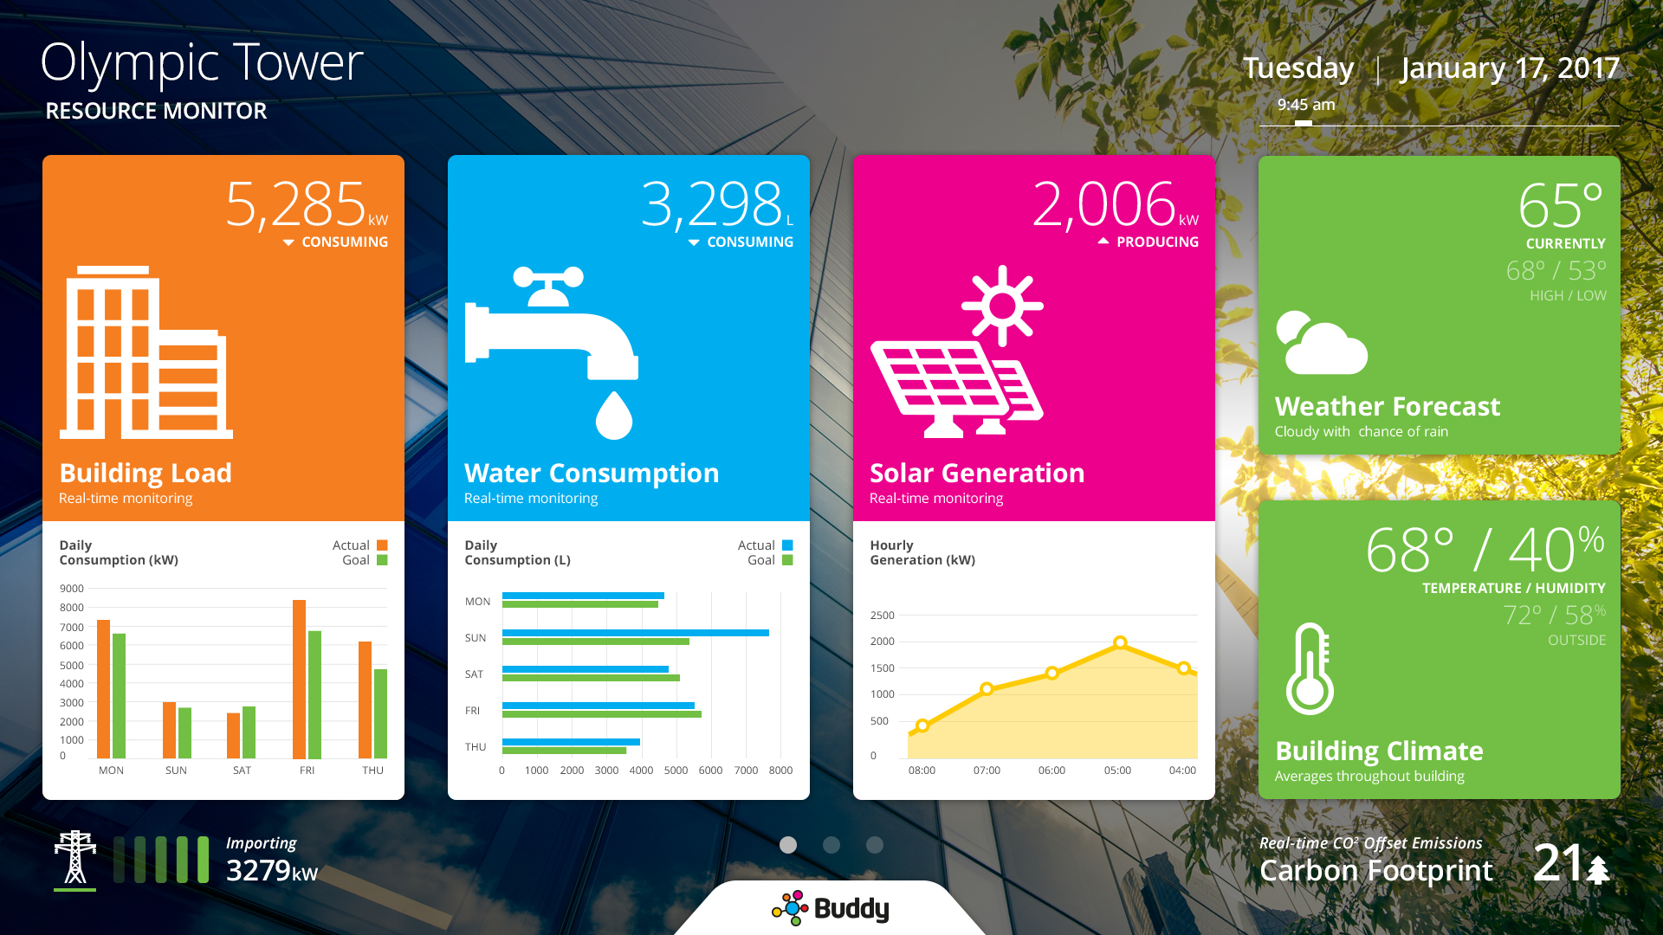

Slide 31
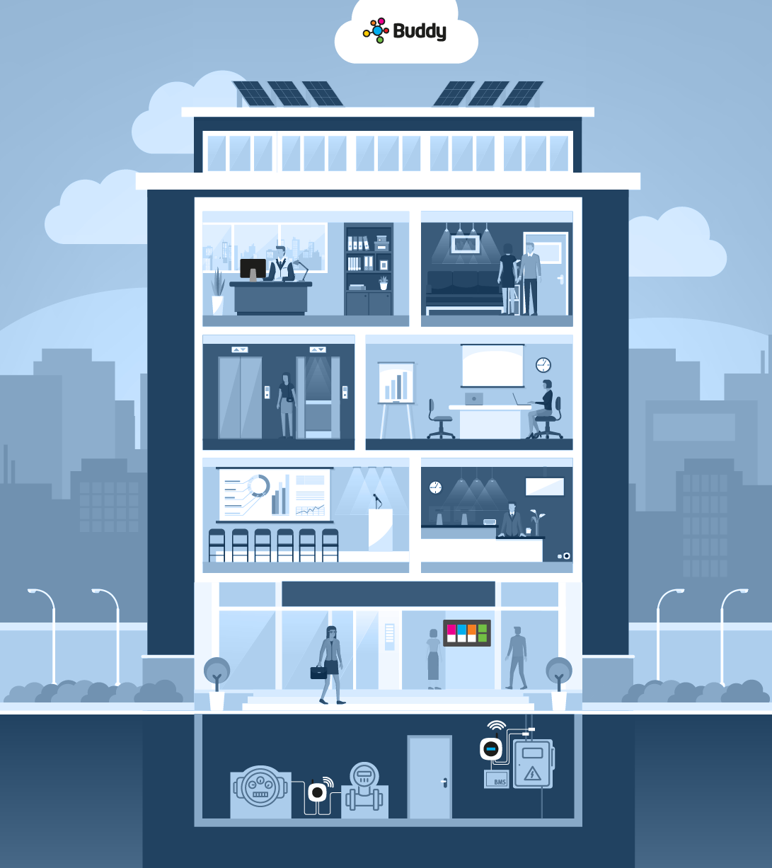
Sustainability Managers & Building Owners
Buddy Cloud
Collects data from Ohm Units
Ohm Portal
Manage Ohm units and set alerts
Sustainability reporting
Target CAPEX for most effective Energy Conservation Measures (ECMs)
Track the RoI of building upgrades
Gas and Water conservation
Ohm Distributed IO & Sense
Monitoring Climate
Lobby Dashboard
Occupant facing experience
Buddy Ohm
Monitoring Electricity while integrating with BMS
Distributed IO
Monitoring Gas and Water consumption

Slide 32
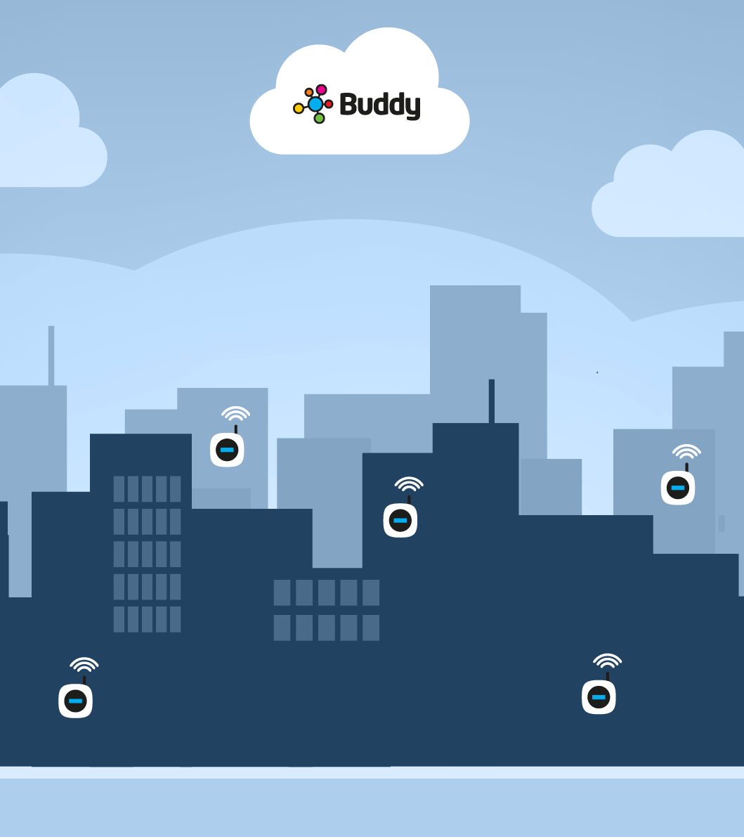
Building & Facility Owners and Managers/Service Providers
Build on top of a single property installation
Portfolio performance management
Troubleshooting of areas or specific plant or equipment
Proactive maintenance
Targeted building upgrades
Buddy Ohm
Real-time monitoring of your properties

Slide 33

Ohm Sense
Monitoring Climate
Ohm Link
Monitoring HVAC, Water and Gas consumption
Buddy Ohm
Monitoring Electricity while integrating with BMS
Ohm Sense
Monitoring Climate
Building Tenants
Improve tenancy comfort • Utility bill validation • Visibility of space use

Slide 34
Process
Through the miracle of modern technology, comprehensive and granular monitoring of building systems now takes weeks instead of months; doesn’t require big capex investment; and delivers immediate insight in real time.
Discovery call
Execute agreement
Site survey
Hardware installation
Backend configuration
Baseline review

Slide 35

Simple Business Model
Most clients experience 6 – 17% reduction in overall energy consumption, as a result of actioning insight from an M&V solution.
For a mid-sized operations or larger, this solution pays for itself within the first year.
No Capital Expenditure
For most customers there is no capital expenditure required.
Inclusive Subscription
Includes hardware lease, installation, configuration, upgrades, support and monitoring.
Easy Renewal
Service automatically renews following initial contract term.
Add Capabilities
Once a baseline is established, customers can add capabilities at any time.

Slide 36
Exercise #2 (again)
Turn to your neighbor and explain in two sentences
or less what Ohm by Digicel does
  Simpler is better
  Ask them to repeat your explanation back
  in their own words
  Did they understand?
10 minutes

Slide 37
Success Stories
Fifth Avenue Theater
  Identified and corrected HVAC scheduling problem two days after installation
  Identified and corrected conflicting heating and air conditioning units two weeks after installation
University of Santa Clara
  Monitoring multiple floors of their dorms
  Creating competition amongst kids to reduce energy spend
Data Center Provider
  Using Ohm Sense to monitor inbound air; room air; and outbound air
  Monitoring HVAC units at the same time to determine overall system efficiency
  Set threshold based alerts to be notified if rooms get too hot or if power fails
Caribbean Resort
  Tracking energy spend against occupancy rate to determine cost per guest
  Planning to use Ohm by Digicel to baseline equipment efficiency and build a business case for retrofit

Slide 38
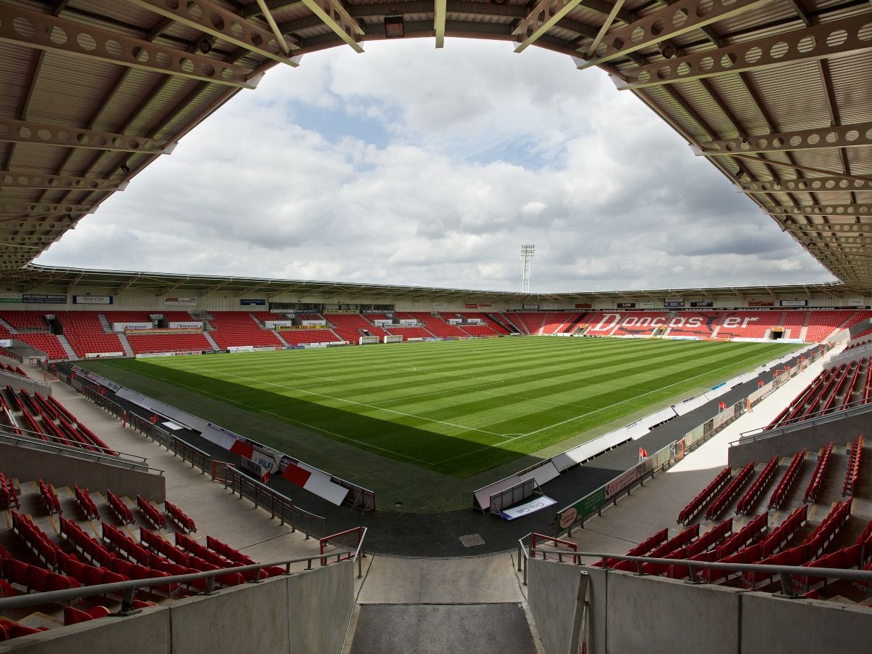

Buddy Ohm Use Case #1: Keepmoat Stadium
Built in 2006
Located in Doncaster, England
Use of building has changed
Identify power anomalies
Validate existing systems
Properly apportion utility bills

Slide 39
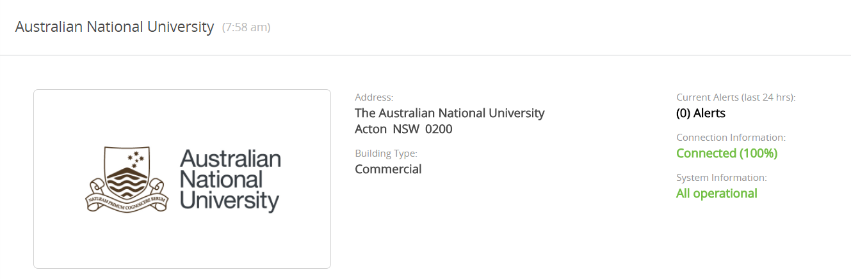
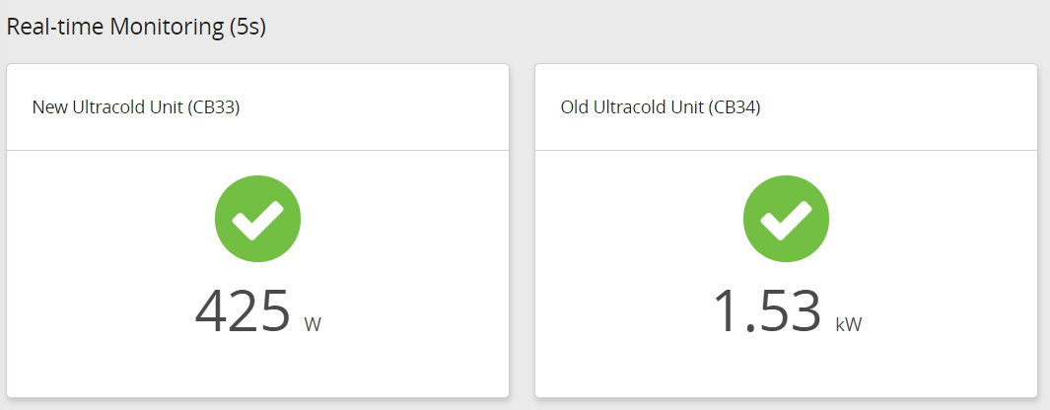
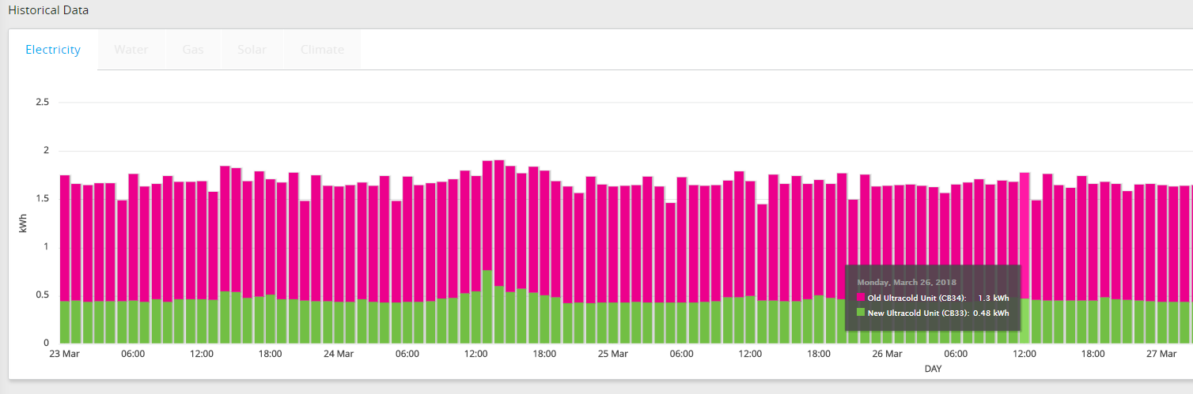
Buddy Ohm Use Case #2: Australian National University
NEW
OLD
480 kW
1300 kW
Immediate insights showed that the new chiller is using 63% less electricity than the old chiller.

Slide 40
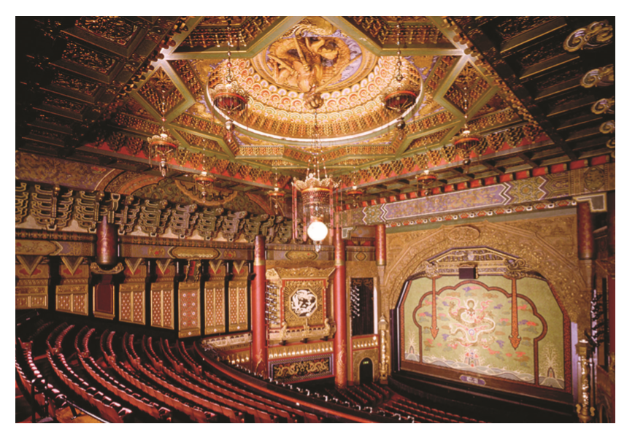
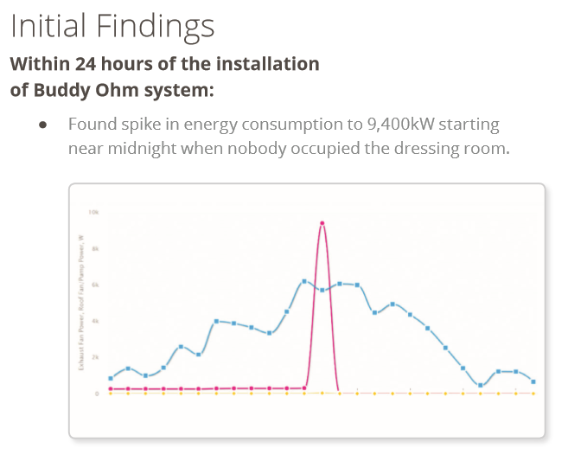
Buddy Ohm Use Case #3: Seattle’s Historic 5th Avenue Theater

Slide 41
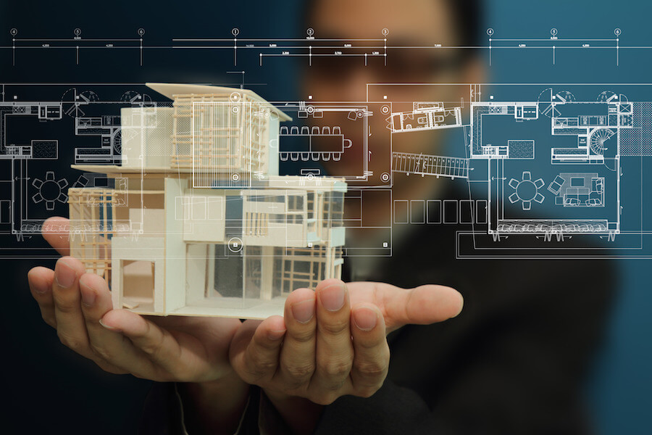
Exercise #3
Build your prospecting introduction
  20-second hook
  Explain the value proposition without
  talking about solution components
    “Buddy Ohm enables clients to…”
  Include a query to end
    “I’m curious about…”
    “How do you…”
    “What is your…”
    “Do you have any concerns with…”
    “Does this sound…”
Practice with your partner
15 minutes

Slide 42
Sales Tools
Introductory presentation
Solution one sheet
Solution data sheet
Theater & multi-tenant building case studies
Hospitality & Higher Education use cases
Solution overview videos
ROI calculator
Quote builder tool
Site survey form
Customer & trial agreements

Slide 43
Buddy Ohm Sales Process
Set meeting
30-minute introduction
Discovery meeting
Site validation & install
Receive Purchase Order
Re-connect to verify value
Email
Cold call
Conferences
Solution overview
Intro deck
Prospect priority
Why are they interested
Monthly utility cost
Site survey form
Schedule install date
Get pictures of fuse panels
What else do they want to measure?
Share credentials within 24-hours
Contract complete
Day 5
Day 8
Day 12
Day 19
Day 33

Slide 44

Exercise #4
With your partner…
  Describe hardware family
  Describe dashboard views
  Explain the business model
  Ask qualifying questions to discover
  likely ROI
  Explain potential savings
  Ask for interest & discovery meeting
30 minutes

Slide 45
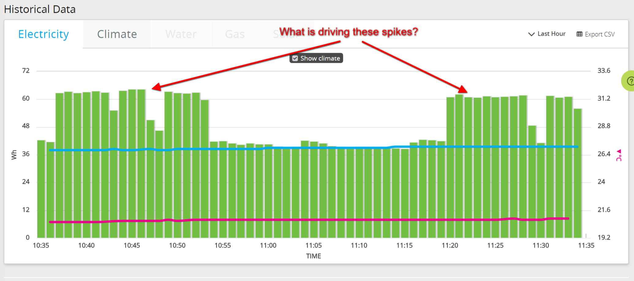
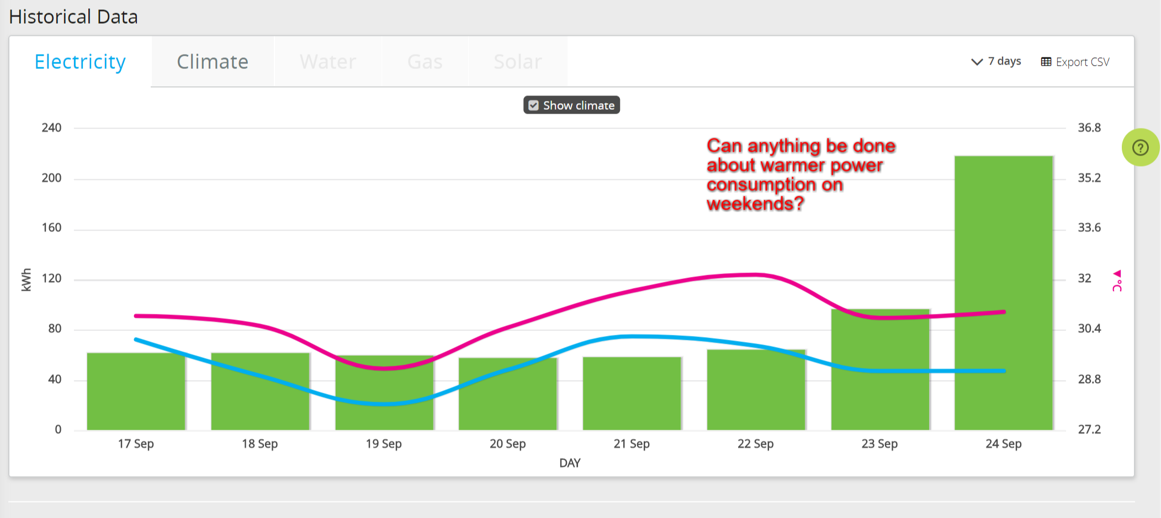
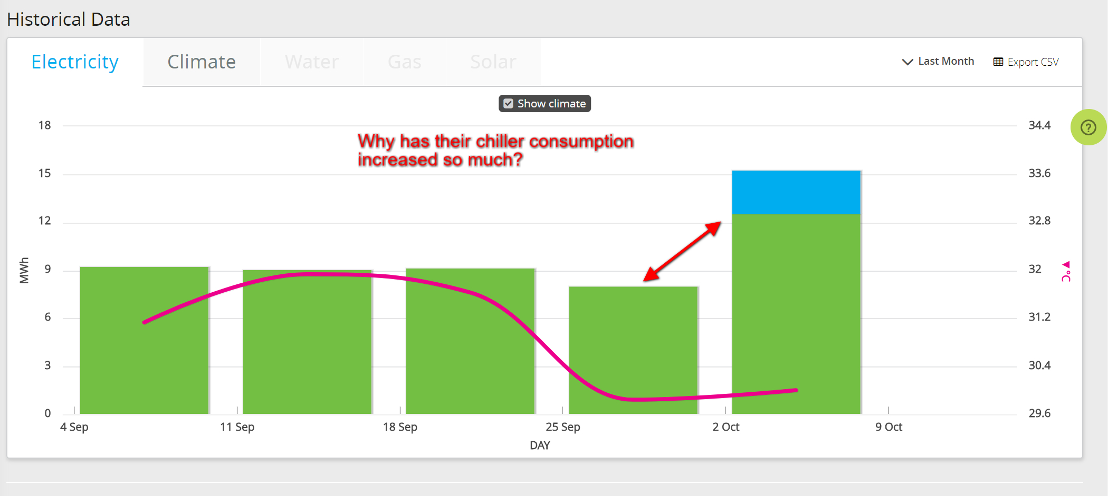
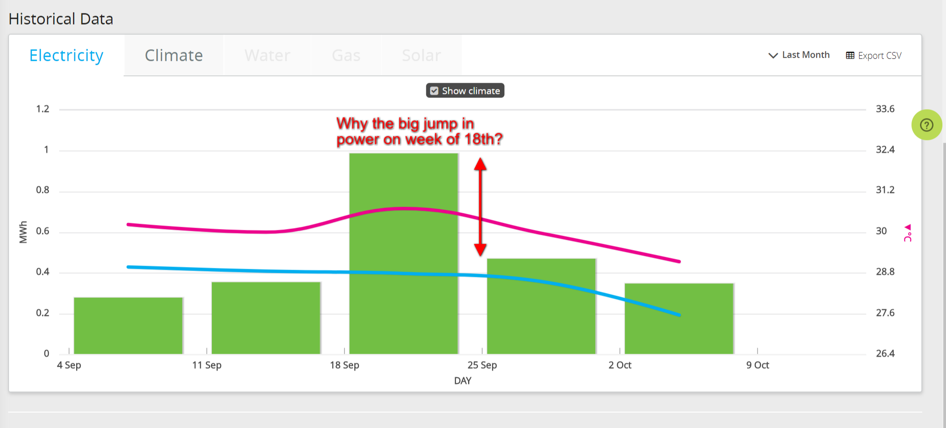
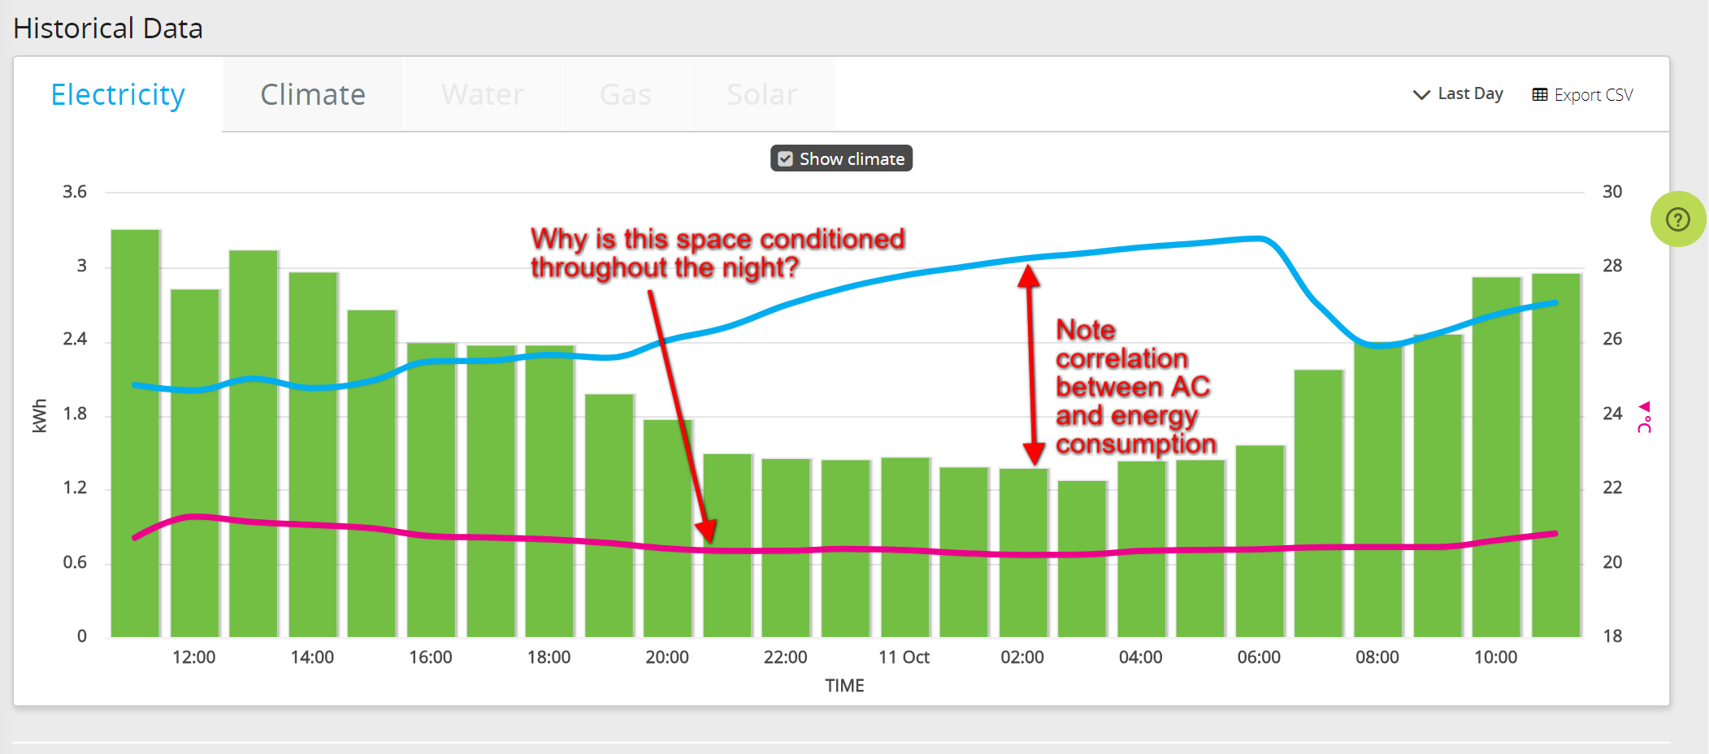
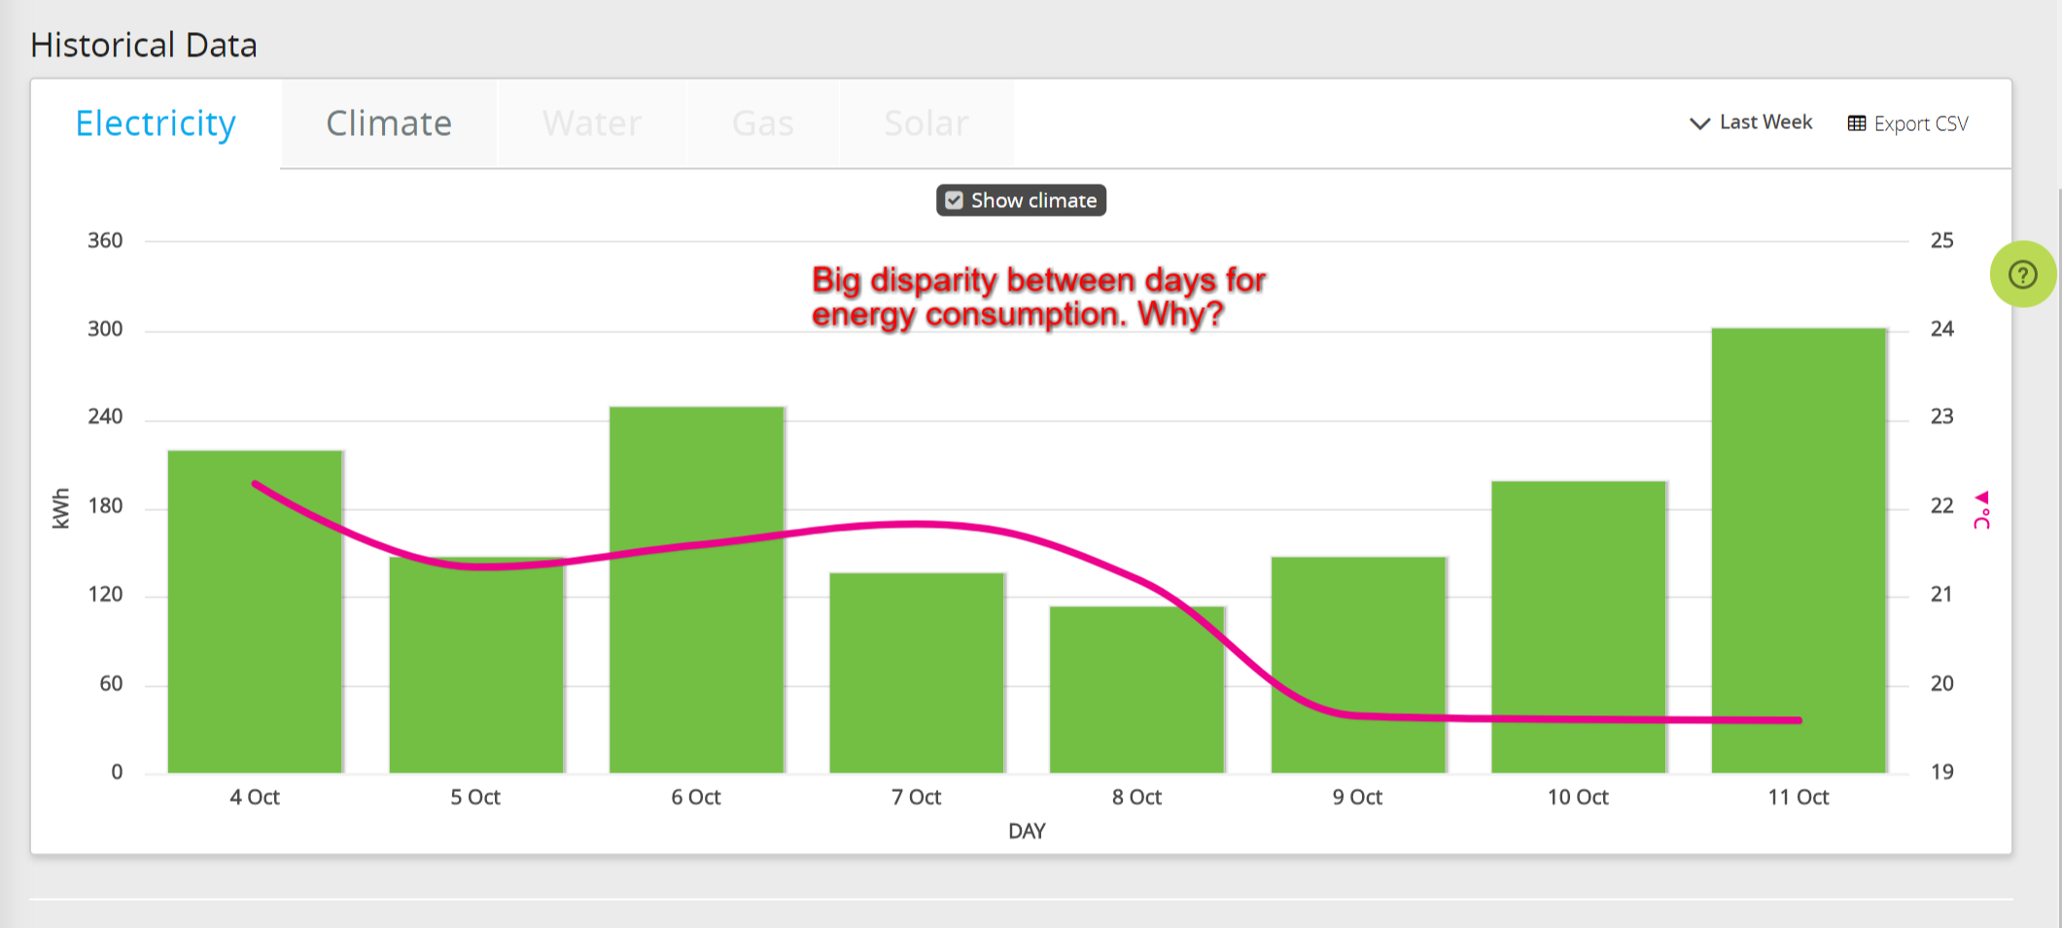
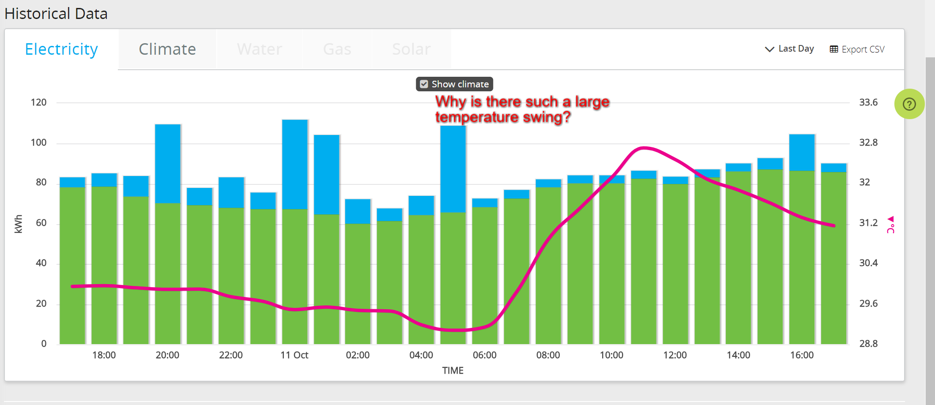
Interpreting Dashboards

Slide 46
Converting Trials
Call the client 2 weeks after installation to ensure they are logging in to view their dashboards
  Answer any questions they have about what they are seeing
  Analyze the operations dashboard with the climate overlaid to look for odd data
Emphasize the point of the trial is to prove the technology
  Does the client agree the equipment is working as expected
  Ask is they see value in getting granular energy consumption data in real time
If the client agrees to the value, recommend moving into production and adding monitoring for additional circuits
  Circuits can be added for no additional charge up to the number of inputs available on the Buddy Ohm and Ohm Link. After that, they will need to add Ohm Links.
If the client doesn’t see the value, recommend monitoring key additional circuits until the end of the trial
  Typical targets include HVAC, Lighting, and big equipment

Slide 47
Maximizing Revenue Potential
Ensure prospect engages with dashboards during pilot
Help client envision potential savings resulting from granular view
Identify key systems to monitor
Ask “What is your monthly utility bill?
Ask “Most clients save between 6 & 17%, what do you think you can save with this type of insight?”
  Use ROI calculator during the call to calculate monthly savings based on client’s estimated savings.
Follow-up 30 days after installation to review progress, recommend additional installation if appropriate

Slide 48
Enabling Prospects to Sell Internally
They probably need support from President, Finance, Facilities, Sustainability, Cost Control
Build ROI calculator with them
Provide data sheet, which explains the solution
Help them develop a vision of the possibilities
Emphasize they can try the system at no ongoing obligation for 30 days

Slide 49
Product Roadmap
Next Update
  Encrypt collected data on device before sending to gateway
  Measure power consumption by phase
  Add Power Factor monitoring function
  Add apparent power function
  Lengthen battery life for Ohm Link and Ohm Sense
  Improve backend provisioning experience
Medium Term (Months)
  Improve mobile experience
  Improve installer app experience
  Add leak detection sensors
  Add ultrasonic flow sensor
  Add occupancy counter
Long term (Years)
  Building Management System control

Slide 50


The simplest way to make data from any connected device valuable
@timritchie2005 | tim@buddy.com| www.buddy.com

